Slide 1
Temporal Dilation in Video-ResNet for Sign Language Translation
Xiaoqian Yang
Master’s Project
Advisor: Dr. Chris Tseng
12/15/2023
Notes:
Thank you all for taking the time to be here. First of all, I want to express my sincere gratitude to Prof. Tseng, my advisor, thank you for picking this interesting topic and guiding me, from literature review to project design, you gave me so much help and you have always been so patient. And my sincere gratitude also goes to Prof.Abri and Dr. Zhang, thank you for being so supportive and patient.

Slide 2
Agenda
Problem Statement
Introduction
Sign language translation approaches
Sign language translation directions
Sign language translation challenges
ResNet
Residual block
Architectural variants
R3D_18, R(2+1)D_18, MC3_18
Training strategy
Zero-short gesture sequence recognition
Temporal dilation
Heuristic post-processing
Dataset
Results
Demo
Q&A

Slide 3
Problem Statement
Sign languages are used by deaf and hard-of-hearing (DHH) people to communicate with others.
Sign languages are complicated and there are over 200 sign languages worldwide.
Traditional communication methods fall short.
Our primary objective is to bridge the gap between sign language users and spoken language users utilizing deep learning techniques to develop a model capable of recognizing a few consecutive signs out of a short video.
Notes:
Sign languages are used by deaf and hard-of-hearing (DHH) people to communicate with others.
Sign languages are very complicated and rely on visual-spatial elements, encompassing handshapes, palm orientations, facial expressions, and body movements
With over 200 sign languages worldwide, each unique in gestures, vocabulary, and grammar, traditional communication methods such as sign language interpreters and translation devices often fall short. Because it is difficult to find Sign language interpreters who are fluent with all sign languages, and translation devices are often impractical.These devices can be expensive, require regular maintenance, and are not readily accessible to all DHH individuals.
Therefore, it is important to promote the use of tools that enable communication between sign language and spoken language users. A breakthrough method for translating sign language is deep learning.
The primary objective of this project is to employ deep learning techniques to develop a model capable of recognizing a few consecutive signs out of a short video，that would be the first step to achieve sign language translation.

Slide 4
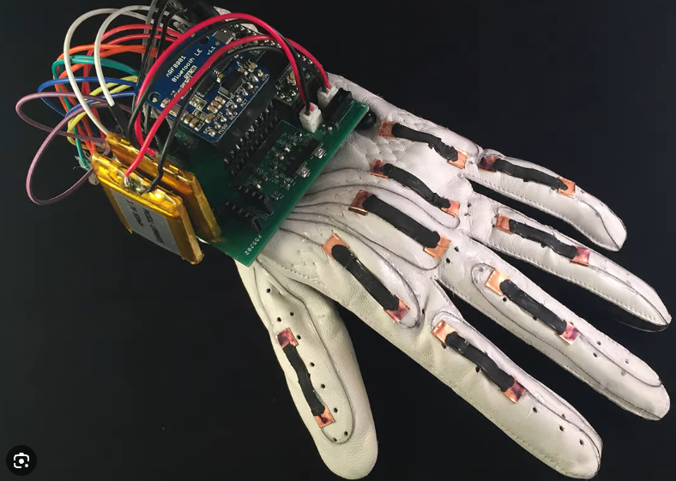
Introduction
Sign Language Translation Approaches:
Sensor-based approach:
Utilize hardware like gloves, rings, accelerometers and other physical devices.
Vision-based approach: ✅
Rely on visual input, such as images and videos, along with audio cues.
Notes:
Sensor-based approach: This approach utilizes hardware solutions like gloves, rings, accelerometers, and other physical devices. These sensors capture the movement and articulation of sign language. However, sensor-based systems are often considered intrusive and uncomfortable by users. Moreover, they may have limitations in capturing non-manual features, for example, it can’t capture the facial expressions, but these features are essential for understanding the nuances of sign language expressions.
Second approach is vision-based approach,
Our work will mainly focus on datasets that are collected using vision-based approach.
This approach mainly relies on visual input, such as images and videos, along with audio cues. This approach also presents challenges such as identifying the start and end of signs, dealing with variations in signing speed among different individuals.

Slide 5
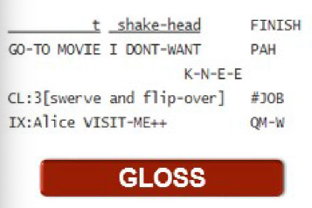
Introduction
Sign Language Translation Directions:
From spoken language text to producing video:
From sign language videos to spoken language text: ✅
Using glosses as an intermediate representation. (Two-staged approach)
video-to-gloss, gloss-to-text
No use of glosses (One-staged approach)✅
video-to-text
Notes:
The quality of translation heavily relies on the accuracy of the sign gloss annotations, potentially causing bottlenecks in the process

Slide 6
Introduction
Sign Language Translation Challenges:
Limited datasets.
Multi-signer scenario
Non-representable signs
Sign languages do not always have a direct and perfect mapping to lexemes or spoken words.
Example: run quickly
Non-local semantic ambiguity
Example: driver —> car & person
wish v.s. hungry
Notes:
Limited Datasets: One of the primary challenges is the availability of limited datasets for training and testing NSLT models. Before the introduction of comprehensive datasets like the RWTH-Phoenix-weather-2014 dataset, many researchers had to rely on private or small datasets. This lack of standardized and extensive data made it difficult to compare results and hindered the development of robust NSLT models.
Multi-Signer Scenario:
Current NSLT approaches primarily focus on scenarios with a single signer. When there are multiple signers in a video, challenges arise. Even the presence of a non-signing person in the video can disrupt the process and introduce noise during feature extraction from sign language videos.
c. Non-Representable Signs:
Sign languages do not always have a direct and perfect mapping to lexemes or spoken words. For instance, conveying an adverb in a signed phrase, such as "run quickly," might involve modifying the signing speed of the word "run." The non-representable nature of such signs poses a challenge in achieving precise translation.
d. Non-Local Semantic Ambiguity:
Sign gestures often depend on the context at both the sentence and word levels. Many signs are compositions of multiple "meta-signs." For instance, the sign for "driver" may require the sequential signing of "car" and "person." The interpretation of "person" may vary depending on the accompanying word, translating to "teacher" or "student." Additionally, some sign gestures are very similar to one another, resulting in non-local semantic ambiguity. For example, without considering the context, distinguishing between signs like "wish" and "hungry" can be difficult.

Slide 7
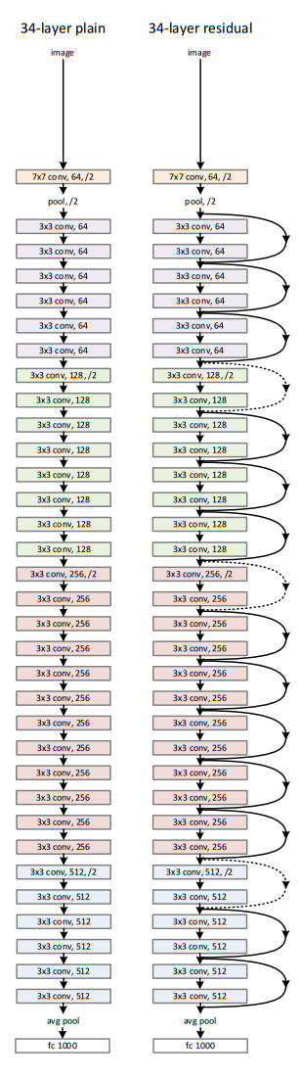
Background: ResNet (Residual Network)
What is it?
Why use it?
Notes:
Let’s talk about the backbone technique used in our study – ResNet, which is short for Residual Network.
What is ResNet? A ResNet is a deep neural network in which the weight layers learn residual functions with reference to the layer inputs. In simple words, is almost similar to the networks which have convolution, pooling, activation and fully-connected layers stacked one over the other. The only construction to the simple network to make it a residual network is the skip connection between the layers. Let’s see the example figure here, On the left, it is 34 layer- plain network, and on the right, some shortcut connects are added, so instead of learning the desired mapping, the network learns to adjust the input through the residual mapping. This is residual network.
Why shall we use ResNet?
We all know that as deep neural network gets deeper, traditional neural networks had trouble training because of issues such as vanishing gradient, and ResNet was introduced to solve this problem.( ResNet introduces the concept of residual learning, utilizing residual blocks with shortcut connections.)
(What is vanishing gradient problem? Vanishing gradient problem is a phenomenon that occurs during the training of deep neural networks, where the gradients that are used to update the network become extremely small or "vanish" as they are back-propogated from the output layers to the earlier layers.)

Slide 8
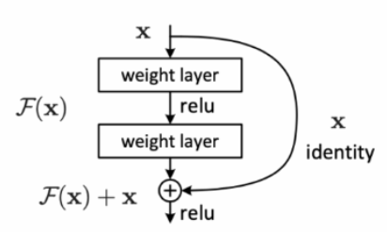
Background: ResNet (Residual Network)
Residual Block:
A deep residual network is formed by sequentially stacking a series of residual blocks.
H(X) =
A Sample Residual Block in a Deep Residual Network. Residual Connection skips two layers in the sample.
Notes:
The key innovation in ResNet is the use of residual blocks. Each block contains a shortcut/skip connection that bypasses one or more layers. Here I put a simple example of one residual block, x is the input of this subnetwork, and it skips two layers, (The function F(x) is commonly expressed through a combination of matrix multiplication, activation functions, and normalization operations such as Batch Normalization or Layer Normalization. ) and the output is Fx + x.
This is one residual block, A residual network is formed by sequentially stacking a series of residual blocks

Slide 9
Background: ResNet (Residual Network)
Architectural Variants:
Some key ResNet architecture variants:
ResNet-18, ResNet-34, ResNet-50, ResNet-101, ResNet-152:
Wide ResNet:
ResNeXt:
DenseNet (Densely Connected Convolutional Networks):
ResNetV2:
Residual Attention Network (RAN):
Notes:
The ResNet (Residual Network) architecture has many variants, each with specific modifications designed to address different challenges or optimize performance. Here are some key ResNet architecture variants:
ResNet-18, ResNet-34, ResNet-50, ResNet-101, ResNet-152:
These variants differ in terms of depth, with the number indicating the total number of layers. For instance, ResNet-18 has 18 layers, and ResNet-152 has 152 layers.
The Wide ResNet architecture increases the width of the residual blocks, i.e., the number of filters, instead of increasing depth. (This helps improve the model's representational capacity without significantly increasing the number of parameters.)
I’ll skip the rest variants, because they are not the focus of our study.

Slide 10
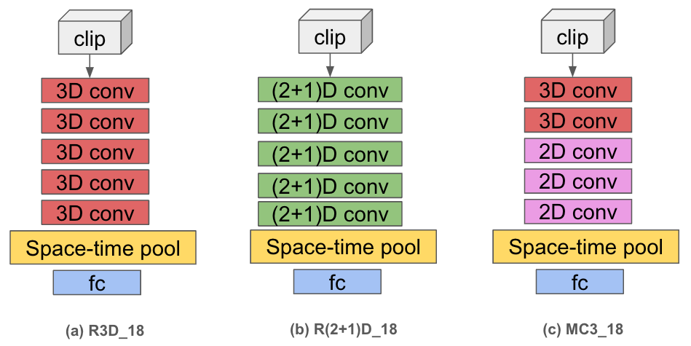
Video-ResNet (3D)
Architectural Variants in our study:
Residual blocks with 3D convolutions.
Decouple spatial and temporal convolutions
Mixed convolutions
Notes:
We adopted three ResNet variant architectures in our study. R3D, R(2+1)D, and MC3
The baseline model is R3D_18, 18 denotes the number of layers. it is a variant of the 3D ResNet architecture. It extends the principles of ResNet to handle three-dimensional data by capturing spatial and temporal features simultaneously, making it well-suited for understanding motion patterns in videos. Each of these rectangle represents a residual block, each block contains a few layers, I’ll show the table in next slides.
Second model is R(2+1)D_18, it is a spatial-temporal variant of R3D. This architecture explicitly decomposing 3D convolution into a 2D spatial convolution followed by a 1D temporal convolution, it separates spatial and temporal model into two steps.
(Advantages: 1. without altering the parameter count, it effectively doubles the number of non-linearities in the network by introducing an additional Rectified Linear Unit (ReLU) activation between the 2D and 1D convolutions within each block. 2. it eases the optimization process. has a lower training loss and a lower testing loss)
Third model is MC3_18, Mixed convolutions. It uses 3D convolutions exclusively in the early layers of the network, while employing 2D convolutions in the later layers.

Slide 11
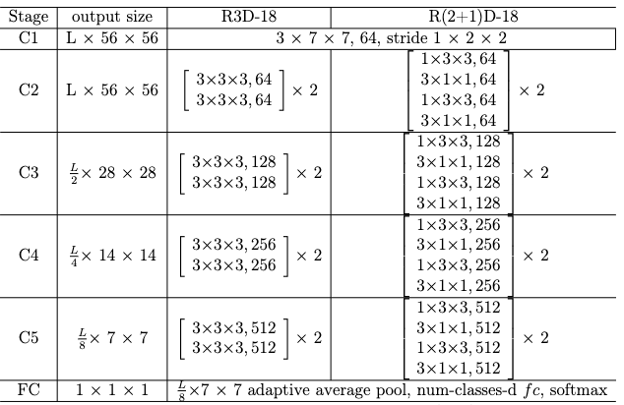
Video-ResNet
Architecture overview of R3D_18 and R(2+1)D_18
Input: 3xLX112X112
Notes:
This table shows the specifications of R3D and R(2+1)D architectures. They both have 18 layers. Each network takes clips consisting of L RGB frames with the size of 112x112 as input. Convolutional residual blocks are shown in brackets, next to the number of times each block is repeated in the stack. I’ll use R3D as an example to explain more in the next slides

Slide 12
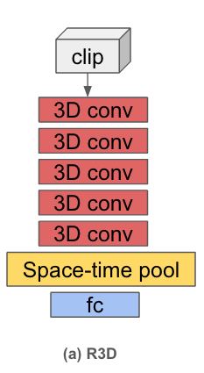
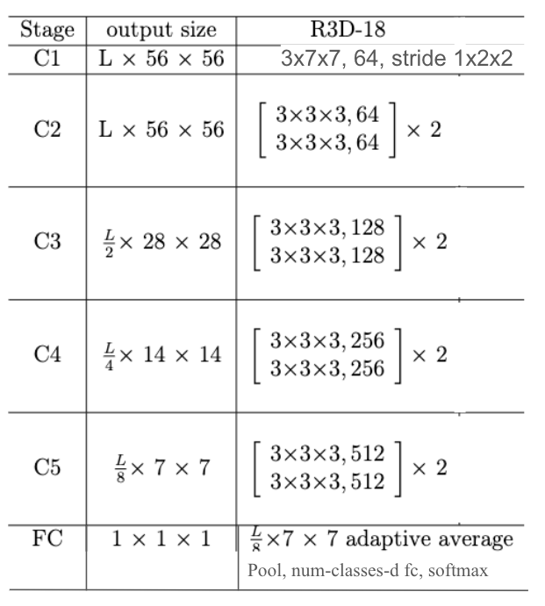
Video-ResNet
More detailed information about R3D_18:
3xLxHXW
C1
3x7x7, 64, stride 1x2x2
C2
3x3x3, 64
3x3x3, 64
3x3x3, 64
3x3x3, 64
3x3x3, 128
3x3x3, 128
C3
3x3x3, 128
3x3x3, 128
Notes:
The input of the model has the shape of 3XLxHxW, 3 refers to the RGB channels here, L is the temporal sequence length, H and W are the spatial dimensions height and width, which are 112x112
The input is first fed into a 3D convolutional layer, which is the C1, and convolutional kernel size 3x7x7, and feature map dimension/filter size 64, stride 1x2x2, 1 is the temporal stride.
Then there are four stages, from C2 to C5. Each stage, there are 2 residual blocks, and each block has two layers. Here I draw C2 and C3 on the left, so we can have a better visual. Another thing worth to be mentioned is that at each stage, the number of feature map dimension increases by 2, and the spatial and temporal dimension are also downsampled by a factor of 2.
At the end of stage C5, we have the feature map size of 512xL/8 *7*7. Then the features are aggregated by an adaptive 3D average pooling at both temporal and spatial dimensions before feeding into the Fully connected layer.
(If we count the layer numbers, it has 18 layers in total.)
(When we first read videos, all frames are resize to (128, 171), and then we crop it to (112, 112))

Slide 13
Training Strategy
Three models R3D_18, R(2+1)D_18, MC3_18 from TorchVision library are pretrained on Kinetics-400 dataset, and then apply end-to-end fine-tuning on the GRIT dataset.
Three models R3D_18, R(2+1)D_18, MC3_18 from TorchVision library train on the GRIT dataset.
Notes:
We have two training strategies: 1 is, 2 is. And I’ll introduce the datasets in a few minutes.

Slide 14
Data Augmentation:
Training Augmentation
random horizontal flip, random crop to (112x112)
Input video frames
downsample
(random selection)
Target frame numbers per clip
resize
A fixed size (128x171)
Train
Inference Transformation
center crop to (112x112)
Input video frames
downsample
(isometric sampling)
Target frame numbers per clip
resize
A fixed size (128x171)
Eval
Notes:
For data augmentation:
the input video frames are first subsampled using random selection to a target frames per clip. The resulting frames are resize into a fixed size, and then we conduct random horizontal flip and random crop with target size. Then we train. All the frames of each video clip are applied the same augmentation simultaneously to keep the temporal consistency

Slide 15
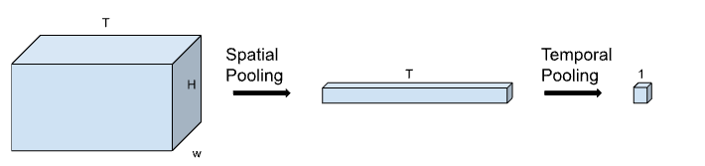
Zero-short Gesture Sequence Recognition
Temporal Dilation
Heuristic Post-processing
Temporal Dilation Strategy: converts the pretrained network to take arbitrary length of input frame sequence and produce a sequence of predictions.
Step 1:
Decoupling Spatial and Temporal Pooling
To be removed at step 2
C x
The 3D adaptive average pooling layer can be decoupled into a 2D spatial average pooling followed by a 1D temporal pooling layer. (Note that the channel dimension is omitted for visualization.)
Notes:
Now for gesture sequence recognition, zero-short means we did not train on gesture sequence. We only trained on single gestures.
we proposed a novel temporal dilation strategy and then conduct a heuristic post-processing for deduplicated predictions.
Inspired by a prior work (of network dilation for the 2D image segmentation task to produce a higher spatial resolution featuremap after pretraining, ) our temporal dilation strategy which converts the pretrained network to take arbitrary length of input frame sequence and produce a sequence of predictions.
Let’s see the figure here, we decouple the 3D adaptive average pooling into a 2D spatial average pooling followed by a 1D temporal pooling layer.

Slide 16
Zero-short Gesture Sequence Recognition
Temporal Dilation Strategy
Step 2:
Top: Original single class video classification Bottom: Converted sequence prediction model using temporal dilation
T
Temporal Pooling
Linear Layer
Softmax ArgMax
Featuremap after spatial pooling
num class
Single class prediction
C
C
T
T
Linear Layer
Softmax ArgMax
T
C
Featuremap after spatial pooling
num class
Sequence prediction
Notes:
This figure shows an overview of the temporal dilation approach.
On the top, it shows how the original single class video classification model works. Featuremap after spatial pooling and temporal pooling is fed into a linear layer for final classification. The predicted class label is given by the maximum indices of the output logits.
As the final FC layer and temporal pooling are linear operations, we could swap their orders. Then we further avoid the temporal averaging in the end, the model would output a sequence of labels, as shown in the bottom. Basically, a linear layer is applied to the featuremap size of T times num of class, resulting a dimension of T times number of class logits. After softmax and argmax operation, we got a sequence of labels.

Slide 17
Zero-short Gesture Sequence Recognition
Heuristic Post-processing:
Predictions after temporal dilation
Final sequence of predictions
filter by confidence score threshold
take the unique consecutive predictions
pick the top-K predictions if know total number of gestures in the video
Notes:
After the temporal dilation, the model is able to produce a sequence of predictions. However, there may be some duplicated predictions for a longer motion action and some noisy predictions in between two valid actions.
So we propose a heuristic-based post-processing strategy to clean up the model predictions.
We first filter the predictions based on the confidence score threshold to remove some noisy predictions in the transition period.
Then we take the unique consecutive predictions to remove the duplicated predictions for a long action.
Finally, we pick the top-K predictions if we have the information of the total number of actions/gestures in the video, e.g. for evaluating on a fixed number of gestures dataset.
((We subsampled the video frames to 32 before feeding into the model. For heuristic post-processing, we use a score threshold of 0.4 to filter out the low confidence predictions, which are lightly to be transition period in between valid gestures. Then we preserve the unique consecutive to remove the duplicated predictions for a longer action. Finally, we pick to top-2 predictions for each video clip, as the test dataset only contains 2 gestures.))

Slide 18
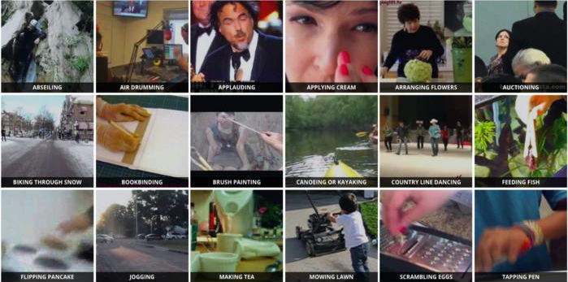
Datasets
Kinetics-400: Used for pretraining.
Notes:
The Kinetics-400 dataset is a large-scale, high-quality dataset for human action recognition in videos. The dataset consists of around 500,000 video clips covering 400 human action classes with at least 400 video clips for each action class. Each video clip lasts around 10 seconds and is labeled with a single action class. The videos are collected from YouTube.

Slide 19
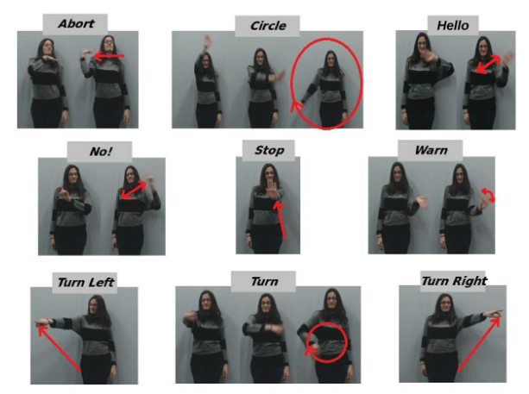
Datasets
Gesture Commands for Robot Interaction Dataset (GRIT):
Used for our fine-tuning process
Notes:
GRIT dataset contains only 9 distinct command gestures, including Abort, Circle,Hello, No, Stop, Turn Right, Turn Left, and Warn. Six different people participated in performing these gestures. Each person executed the same gesture at least 10 times, resulting in a total of 543 recorded videos, which is a relatively small dataset, but it is perfect for our first baby step in sign language translation. (We randomly select 100 samples for model evaluation and use the remaining 443 videos for training.)

Slide 20
Datasets
Gesture Sequence Dataset:
Used to evaluation our model performance on Gesture sequence prediction.
abort_hello
hello_abort
stop_no
turn left_turn right
circle_turn
no_stop
turn_circle
turn right_turn left
Notes:
This is the dataset we generated ourselves, we generated 4830 videos of 8 different categories, and each category corresponds to a combination of 2 consecutive gestures, including

Slide 21
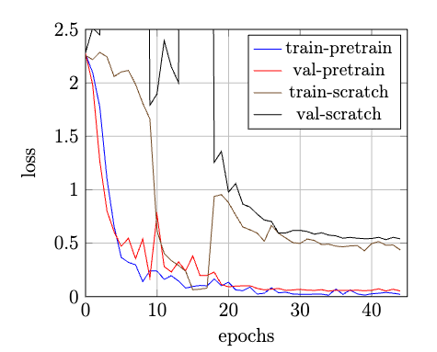
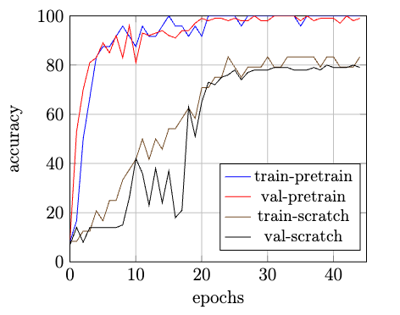
Results
Single Gesture Recognition:
Pretrained v.s. from Scratch: Use R3D_18 as the baseline model.
Notes:
The pretraining makes the network much easier to learn on the gesture recognition task, with better training and validation losses.
Pretrained model: The training and validation accuracy are improved significantly over the entire training time. It achieves 99% accuracy outperforming the train-scratch baseline of 79% by a large margin.

Slide 22
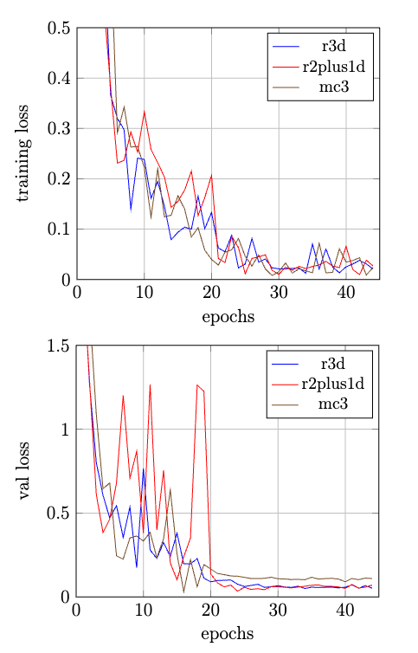
Results
Single Gesture Recognition:
Transfer learning results using R3D_18, R(2+1)D_18, and MC3_18
Notes:
Now that we know pretraining helps in the gesture recognition task, so we use pretrained models for all three models.
All models achieve very similar overall accuracy (R3D: 99%, R(2+1)D:98%, M3C: 98%).
We can see that all three models are performing very similar in training. MC3 model does not generalize as well as other algorithms with a worse validation loss. R(2+1)D loss is unstable during the training and validation process.

Slide 23
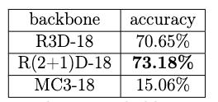
Results
Zero-short Evaluation Results on Gesture Sequence Recognition:
Analysis: R(2+1)D decouples spatial and temporal features, which helps learn discriminative features along different axes and thus works well with the temporal dilation strategy.
Notes:
R(2+1)D achieves the best zero-short ability for
gesture sequence recognition of 73.18% accuracy. R3D also achieves comparable results
of 70.65%. MC3 model does not perform well.
We hypothesize that the architecture of R(2+1)D decouples the representation of spatial and temporal feature learning, which helps the model to learn discriminative features along different axes and thus works well with the temporal dilation strategy.

Slide 24
Conclusion:
Our achievement:
Introduce a learning free Temporal Dilation Strategy
Disadvantages:
The heuristic stage is not differentiable or end-to-end learnable
Improvement:
Try to add a transformer decoder on top of the Video-ResNet feature extraction.
Notes:
The proposed method effectively converts a pretrained network for sequence
prediction without retraining.However, it requires a heuristic post-processing stage to filter out invalid and duplicated predictions.
Disadvantages:
The heuristic stage is not differentiable or end-to-end learnable, which limits the potential of supervised learning from large scale data.
The model has difficulty in distinguishing similar actions, such as "turn left" and "turn right", which may be improved using contextual information.
Improvement:
The transformer architecture is end-to-end differentiable for sequence prediction, and can learn the contextual information effectively with a global receptive-field size. So we can try to add a transformer decoder on top of the Video-ResNet feature extraction.

Slide 25
Demo
Code and pretrained models will be released.

Slide 26
Q & A
Thank you!

Slide 27
Appendix – Implementation Details
We adopt the Kinetics-400 pretrained Video-ResNet models from TorchVision library. R3D-18, MC3-18 and R(2+1)D-18 are used in this study. We initiate the final fully connected layer from scratch for 9-class prediction on the GRIT dataset.
The input videos are downsampled into 16 frames using random frame dropout for training, and equidistant sampling for evaluation. The video frames are resized to the size 128×171, and then conduct random horizontal flip and random crop to the size of 112 × 112 (consistent crop across video clip). Center crop for evaluation is used for evaluation.
The model has been trained using 4 GPUs in a distributed setting with a batch
size of 96. The model is trained for 45 epochs, and a initial learning rate of 0.01. Step learning rate decay is applied at 20, 30 and 40 epochs with a gamma of 0.1. We use standard SGD optimizer with a momentum of 0.9 and weight decay of 0.0001. Linear learning rate warm-up is applied to the first 10 epochs.

